Slide 1
Graph: Shortest path
Session 20
Henry Lucky, S.Kom. M.Kom.

Slide 2
Outline Materials
Session 20
Shortest path problem
Bellman Ford algorithm
Comparing Bellman ford and Dijkstra algorithm

Slide 3
Learning outcomes
LO 1: Explain fundamental concept of analysis algorithms
LO 2: Apply algorithm techniques and methods
LO 3: Solve a problem using specific algorithm.
LO 4: Compare several algorithm design methods

Slide 4
Shortest path Problem
Introduction
How can we find the shortest route between two points on a road map?
Model the problem as a graph problem:
Road map is a weighted graph:
vertices = cities
edges = road segments between cities
edge weights = road distances
Goal: find a shortest path between two vertices (cities)

Slide 5

Shortest path Problem
Definition
Input:
Directed graph G = (V, E)
Weight function w : E → R
Weight of path p = (v0, v1, . . . , vk)
Shortest-path weight from u to v:
δ(u, v) = min w(p) : u v if there exists a path from u to v
∞ otherwise
Note: there might be multiple shortest paths from u to v

Slide 6
Shortest path problem
Variants of shortest path
Single-source shortest paths
G = (V, E) ⇒ find a shortest path from a given source vertex s to each vertex v ∈ V
Single-destination shortest paths
Find a shortest path to a given destination vertex t from each vertex v
Reversing the direction of each edge ⇒ single-source
Single-pair shortest path
Find a shortest path from u to v for given vertices u and v
All-pairs shortest-paths
Find a shortest path from u to v for every pair of vertices u and v

Slide 7
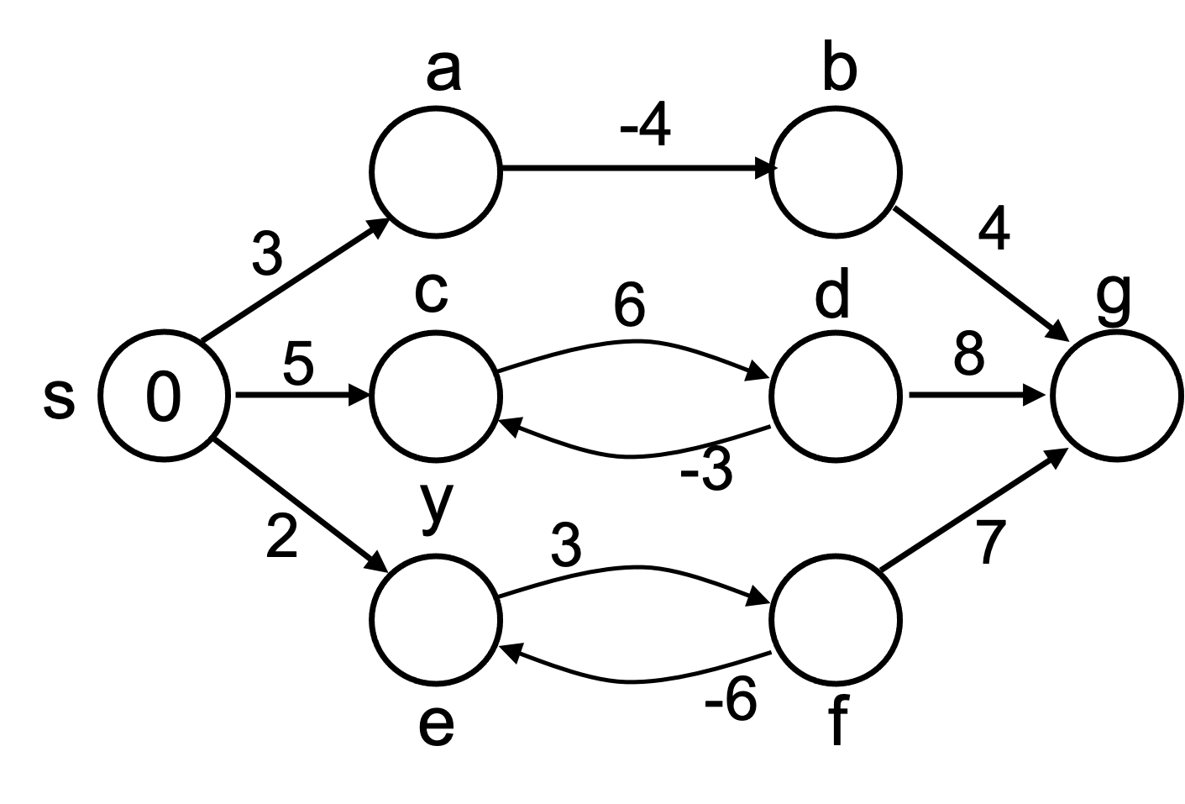
Shortest path problem
Negative-weight edges
Negative-weight edges may form negative-weight cycles
If such cycles are reachable from
the source, then δ(s, v) is not properly
defined!
Keep going around the cycle, and get
w(s, v) = - ∞ for all v on the cycle

Slide 8
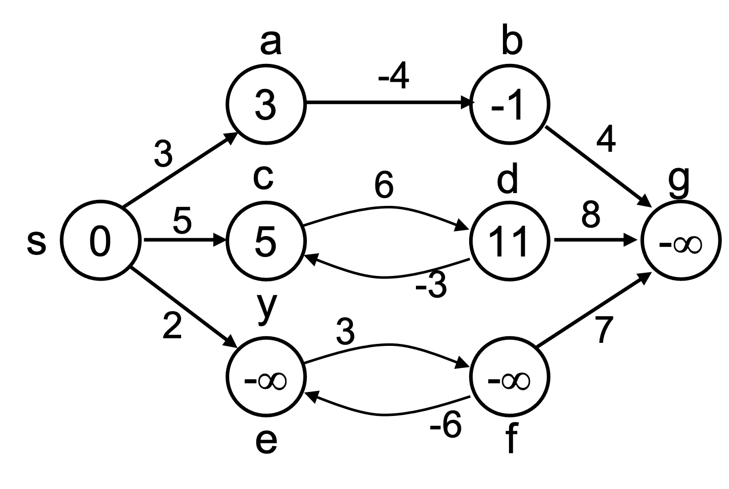
Shortest path problem
Negative-weight edges
s → a: only one path
δ(s, a) = w(s, a) = 3
s → b: only one path
δ(s, b) = w(s, a) + w(a, b) = -1
s → c: infinitely many paths
⟨s, c⟩, ⟨s, c, d, c⟩, ⟨s, c, d, c, d, c⟩
cycle has positive weight (6 - 3 = 3)
⟨s, c⟩ is shortest path with weight δ(s, b) = w(s, c) = 5

Slide 9
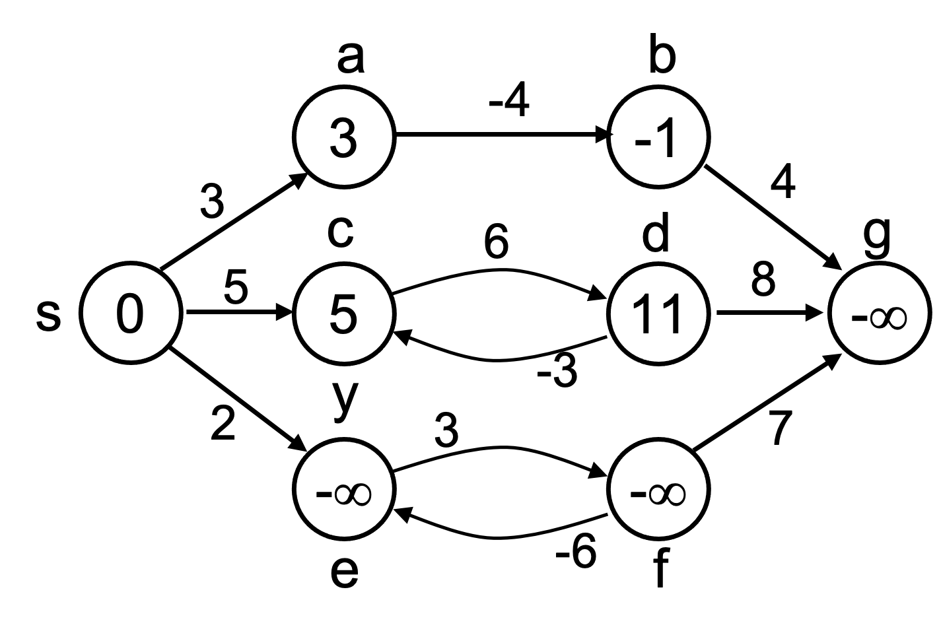
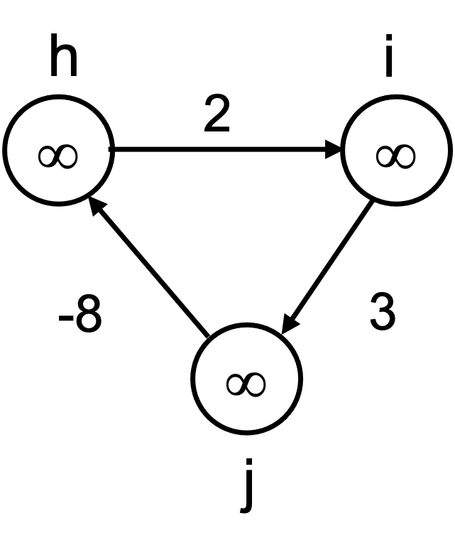
Shortest path problem
Negative-weight edges
s → e: infinitely many paths:
⟨s, e⟩, ⟨s, e, f, e⟩, ⟨s, e, f, e, f, e⟩
cycle ⟨e, f, e⟩ has negative weight:
3 + (- 6) = -3
can find paths from s to e with arbitrarily large negative weights
δ(s, e) = - ∞ ⇒ no shortest path exists between s and e
Similarly: δ(s, f) = - ∞, δ(s, g) = - ∞
h, i, j not
reachable
from s
δ(s, h) = δ(s, i) = δ(s, j) = ∞

Slide 10
Shortest path problem
Cycles
Can shortest paths contain cycles?
Negative-weight cycles:
Shortest path is not well defined
Positive-weight cycles:
By removing the cycle, we can get a shorter path
Zero-weight cycles:
No reason to use them
Can remove them to obtain a path with same weight
No!
No!
No!

Slide 11

Shortest path problem
Optimal substructure of shortest path
Given (Subpaths of shortest paths are shortest paths):
A weighted, directed graph G = (V, E)
A weight function w: E → R,
A shortest path p = ⟨v₀, v₁, . . . , v_{k}⟩ from v₀ to v_{k}
A subpath of p: p_{ij} = ⟨v_{i}, v_{i+1}, . . . , v_{j}⟩, with 0 ≤ i ≤ j ≤ k
Then: p_{ij} is a shortest path from v_{i} to v_{j}
Proof: p = v₀ v_{i} v_{j} v_{k}
w(p) = w(p_{0i}) + w(p_{ij}) + w(p_{jk})
Assume ∃ p_{ij}’ from v_{i} to v_{j} with w(p_{ij}’) < w(p_{ij})
⇒ w(p’) = w(p_{1i}) + w(p_{ij}’) + w(p_{jk}) < w(p) contradiction!
Optimal substructure is one of the key indicators that dynamic programming and the greedy method might apply!

Slide 12
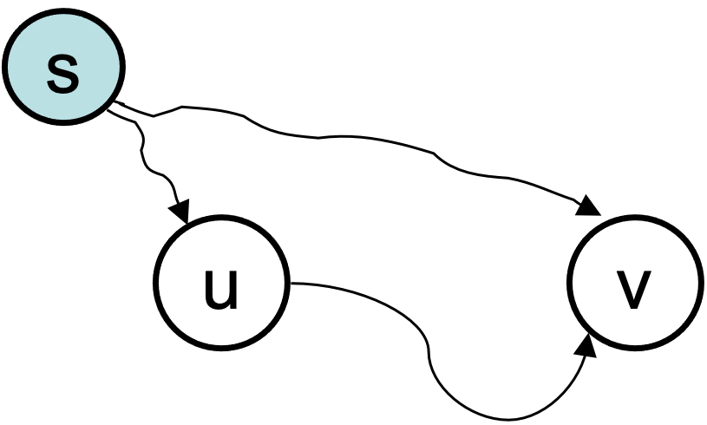
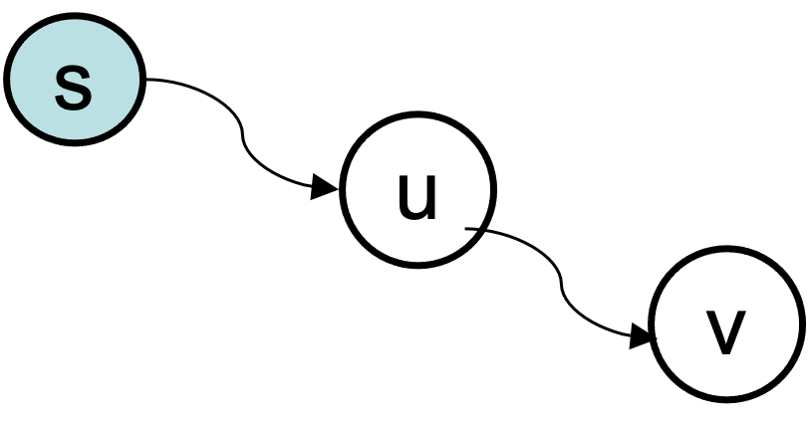
Shortest path problem
Triangle inequality
For all (u, v) ∈ E, we have:
δ (s, v) ≤ δ (s, u) + w (u, v)
If u is on the shortest path to v we have the equality sign

Slide 13
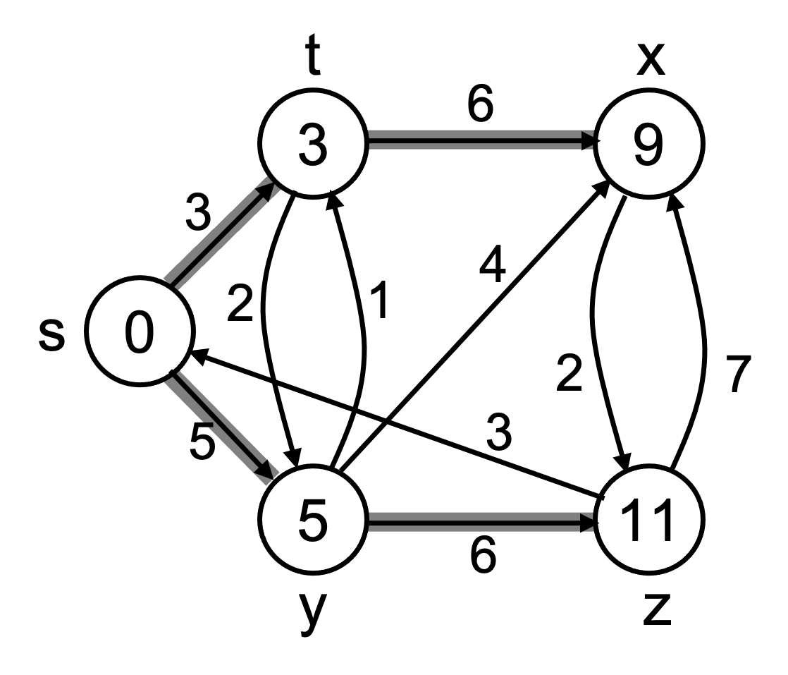
Shortest path problem
Notation
For each vertex v ∈ V:
δ(s, v): shortest-path weight
d[v]: shortest-path weight estimate
Initially, d[v]=∞
d[v]→δ(s,v) as algorithm progresses
π[v] = predecessor of v on a shortest path from s
If no predecessor, π[v] = NIL
π induces a tree—shortest-path tree

Slide 14
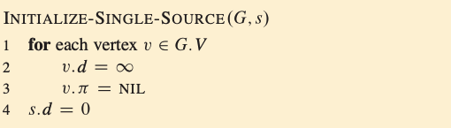
Shortest path problem
Initialization
All the shortest-paths algorithms start with INITIALIZE-SINGLE-SOURCE(G, s) where G is the graph, and s is the source vertex.

Slide 15
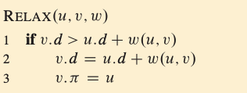
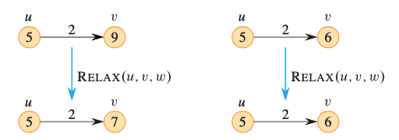
Shortest path problem
Relaxation
Relaxing an edge (u, v) = testing whether we can improve the shortest path to v found so far by going through u
<- we can improve the shortest path to v
After relaxation:
v.d ≤ u.d + w(u, v)
no change

Slide 16
Shortest path problem
Algorithm
Bellman-Ford algorithm
Negative weights are allowed
Negative cycles reachable from the source are not allowed
Dijkstra’s algorithm (You have learned this)
Negative weights are not allowed
Operations common in both algorithms:
Initialization
Relaxation

Slide 17
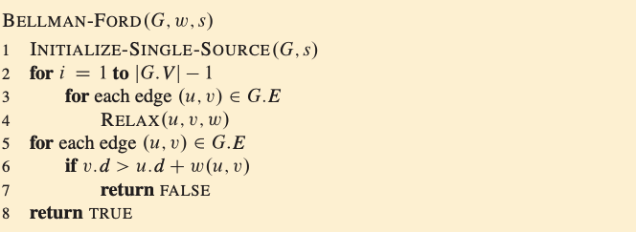
Bellman-ford
Procedure

Slide 18
Bellman ford
Algorithm
Single-source shortest path problem
Computes δ(s, v) and π[v] for all v ∈ V
Allows negative edge weights - can detect negative cycles (Second Loop).
Returns TRUE if no negative-weight cycles are reachable from the source s
Returns FALSE otherwise ⇒ no solution exists

Slide 19
Bellman-ford
Algorithm
Idea (First Loop):
Each edge is relaxed |V–1| times by making |V-1| passes over the whole edge set.
To make sure that each edge is relaxed exactly |V – 1| times, it puts the edges in an unordered list and goes over the list |V – 1| times.

Slide 20
Example
t
x
5
∞
∞
–2
6
–3
8
s
0
7
–4
7
2
∞
∞
9
y
z

Slide 21
Example
t
x
5
6
∞
–2
6
–3
8
s
0
7
–4
7
2
7
∞
9
y
z

Slide 22
Example
t
x
5
6
4
–2
6
–3
8
s
0
7
–4
7
2
7
2
9
y
z

Slide 23
Example
t
x
5
2
4
–2
6
–3
8
s
0
7
–4
7
2
7
2
9
y
z

Slide 24
Example
t
x
5
2
4
–2
6
–3
8
s
0
7
–4
7
2
7
-2
9
y
z

Slide 25
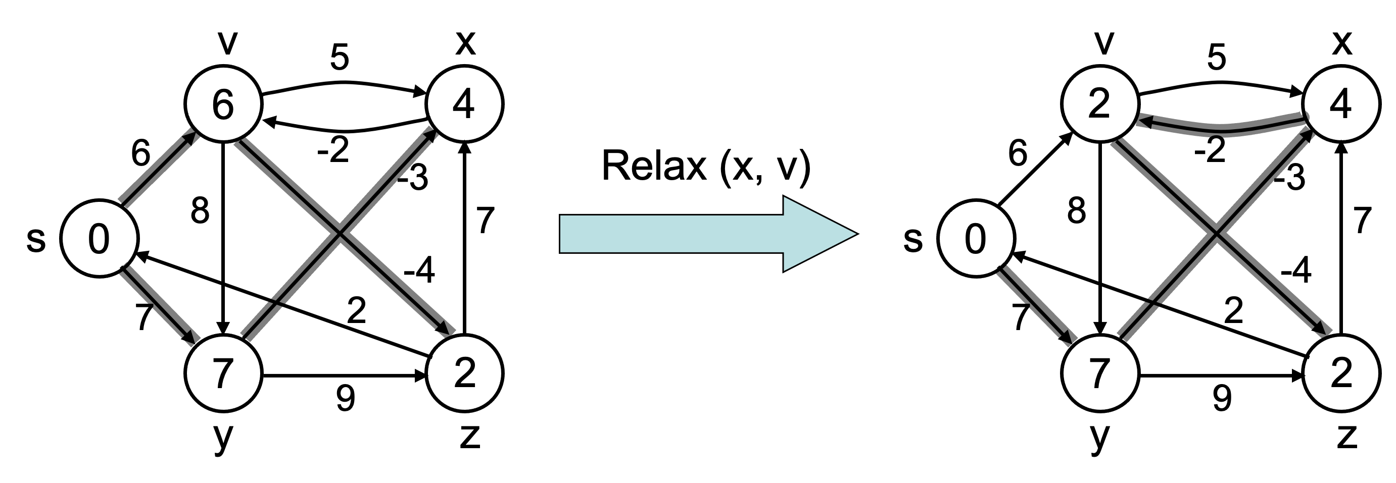
Bellman-ford
Property
Upper-bound property
We always have d[v] ≥ δ (s, v) for all v.
The estimate never goes up – relaxation only lowers the estimate

Slide 26
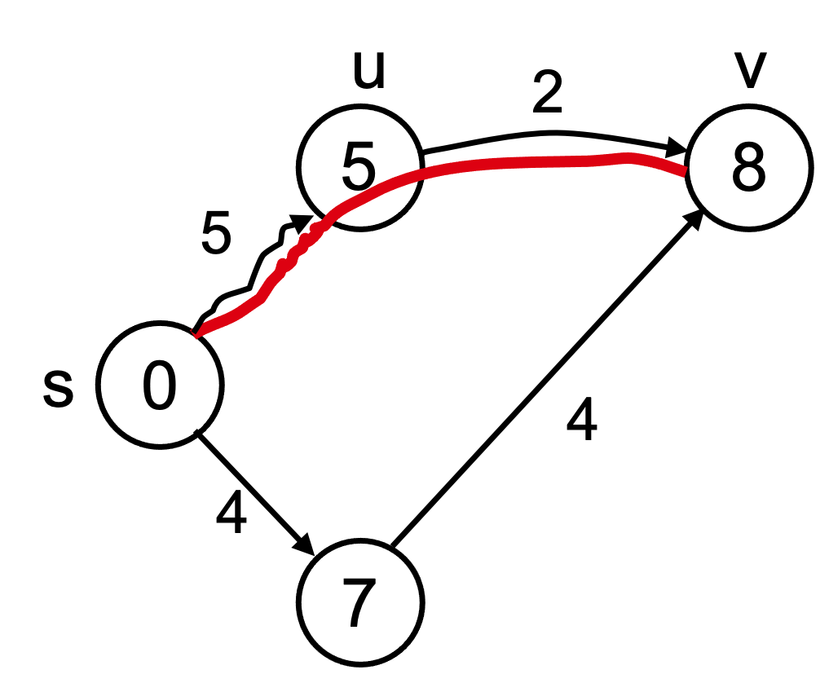
Bellman-ford
property
Convergence property
If s u → v is a shortest path, and if u.d = δ(s, u) at any time prior to relaxing edge (u, v), then v.d = δ(s, v) at all times after relaxing (u, v).
If v.d > δ(s, v) ⇒ after relaxation:
v.d = u.d + w(u, v)
v.d = 5 + 2 = 7
Otherwise, the value remains unchanged, because it must have been the shortest path value

Slide 27
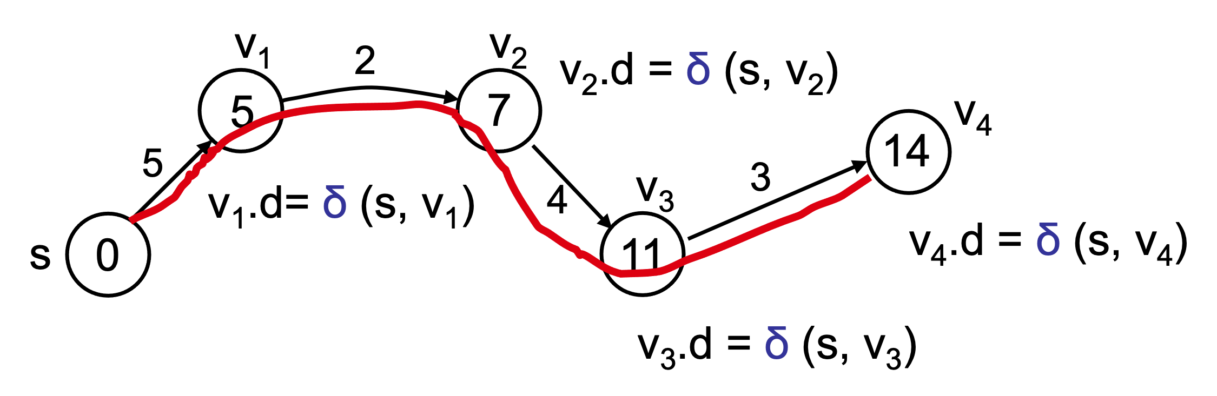
Bellman-ford
property
Path relaxation property
Let p = ⟨v₀, v₁, . . . , v_{k}⟩ be a shortest path from s = v₀ to v_{k}. If we relax, in order, (v₀, v₁), (v₁, v₂), . . . , (v_{k-1}, v_{k}), even intermixed with other relaxations, then v_{k} .d= δ (s, v_{k}).

Slide 28
Bellman-ford
correctness
Theorem: Show that v.d = δ (s, v), for every v, after |V-1| passes.
Case 1: G does not contain negative cycles which are reachable from s
Assume that the shortest path from s to v is
p = ⟨v₀, v₁, . . . , v_{k}⟩, where s=v₀ and v=v_{k}, k ≤ |V-1|
Use mathematical induction on the number of passes i to show that:
v_{i}.d = δ (s, v_{i}) , i=0,1,…,k

Slide 29
Bellman-ford
correctness
Base Case: i=0 v₀.d = δ (s, v₀)= δ (s, s)= 0
Inductive Hypothesis: v_{i-1}.d= δ (s, v_{i-1})
Inductive Step: v_{i}.d= δ (s, v_{i})
After relaxing (v_{i-1}, v_{i}):
v_{i}.d ≤ v_{i-1}.d + w= δ (s, v_{i-1})+w= δ (s, v_{i})
From the upper bound property: v_{i}.d≥ δ (s, v_{i})
Therefore, v_{i}.d=δ (s, v_{i})

Slide 30
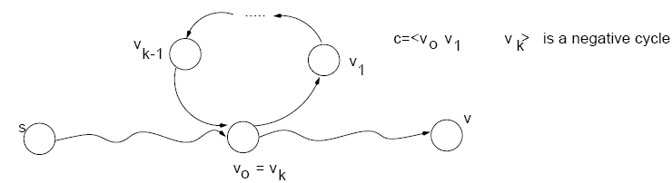
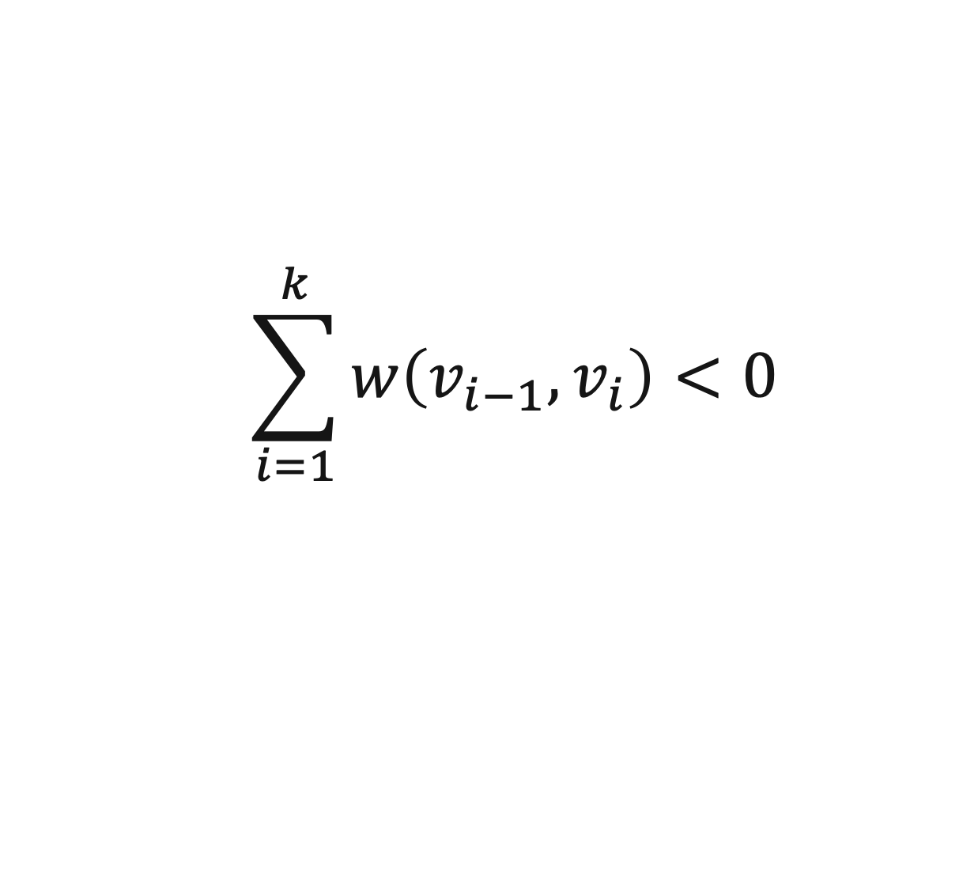
Bellman-Ford
Correctness
Case 2: G contains a negative cycles which is reachable from s
$$\sum_{i=1}^{k}{w\left(v_{i−1},v_{i}\right)}<0$$

Slide 31
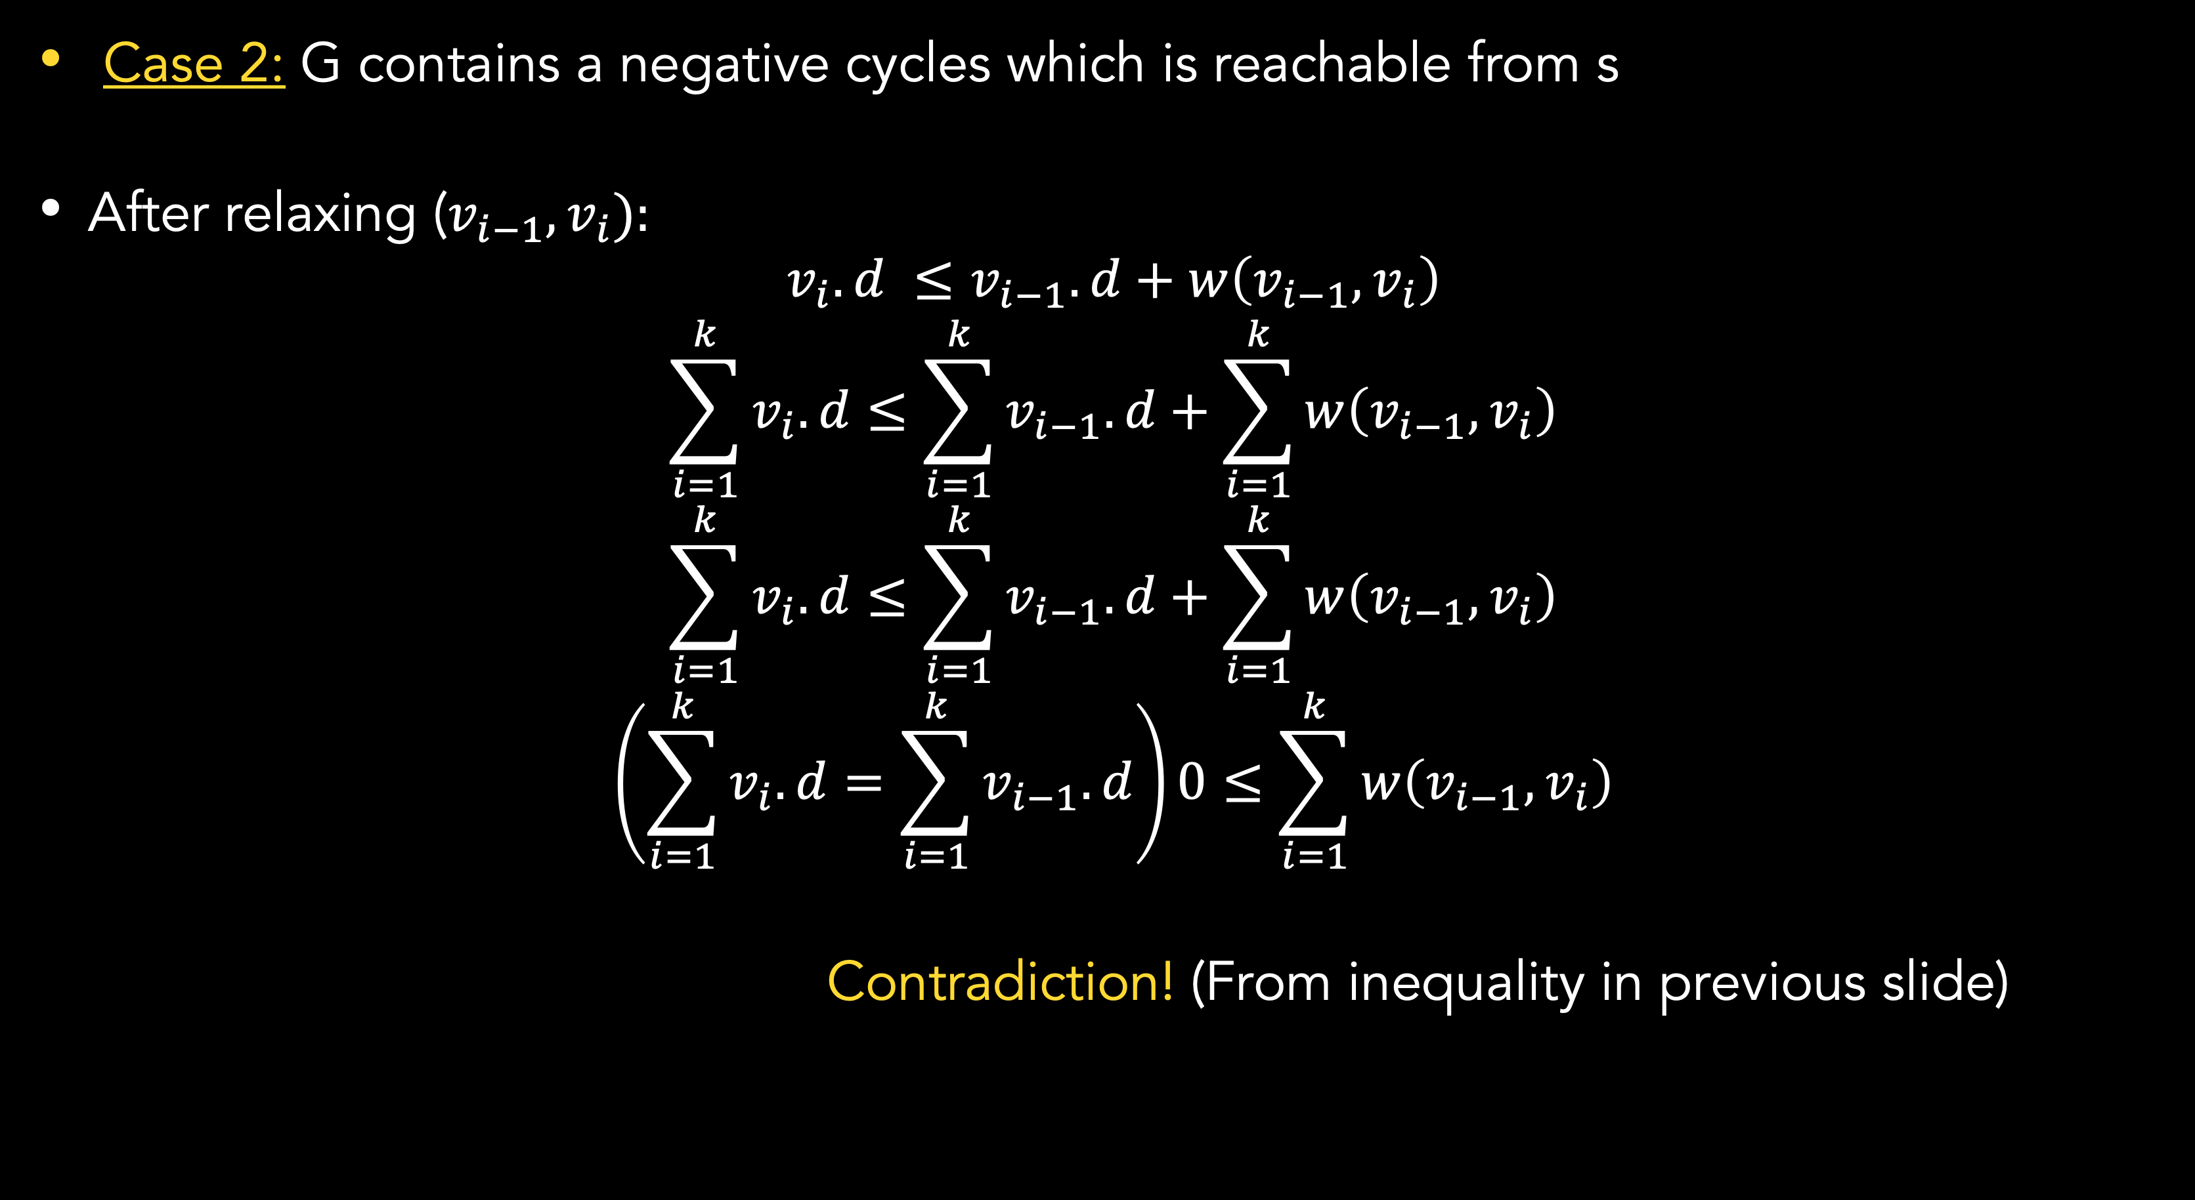
Bellman-Ford
Correctness
Case 2: G contains a negative cycles which is reachable from s
After relaxing ($v_{i−1}, v_{i}$):
$$v_{i}.d ≤v_{i−1}.d+w\left(v_{i−1},v_{i}\right)$$
$$\sum_{i=1}^{k}{v_{i}.d}≤\sum_{i=1}^{k}{v_{i−1}.d}+\sum_{i=1}^{k}{w\left(v_{i−1},v_{i}\right)}$$
$$\sum_{i=1}^{k}{v_{i}.d}≤\sum_{i=1}^{k}{v_{i−1}.d}+\sum_{i=1}^{k}{w\left(v_{i−1},v_{i}\right)}$$
$$\left(\sum_{i=1}^{k}{v_{i}.d}=\sum_{i=1}^{k}{v_{i−1}.d}\right)0≤\sum_{i=1}^{k}{w\left(v_{i−1},v_{i}\right)}$$
Contradiction! (From inequality in previous slide)
Proof by
Contradiction:
suppose the
algorithm
returns a
solution

Slide 32
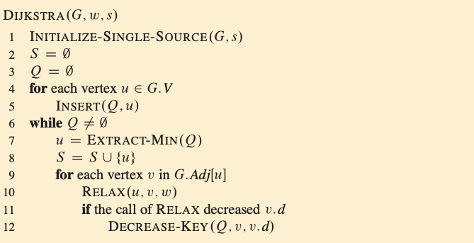
Comparing Bellman ford and Dijkstra algorithm
Refreshment on dijkstra
Running time depends on specific implementation on min-priority queue Q.

Slide 33
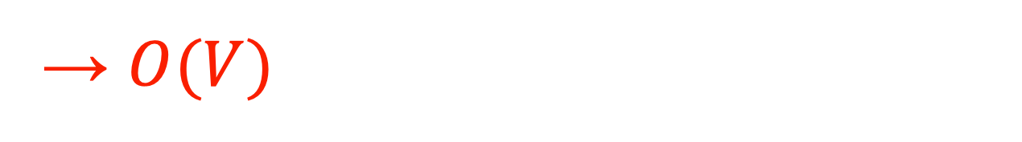
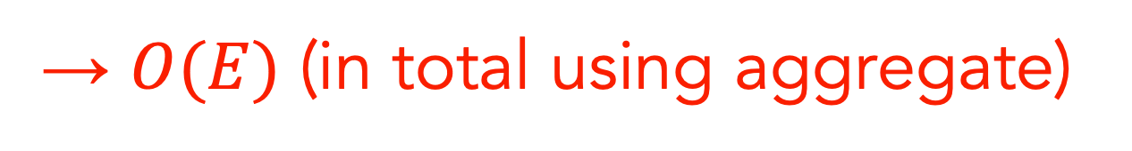

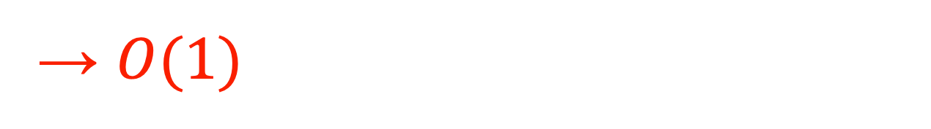


Comparing Bellman ford and Dijkstra algorithm
Refreshment on dijkstra
Total → $O\left(V^{2}+E\right)=O\left(V^{2}\right)$
Simple array Implementation on min-priority queue Q.
→ $O(1)$
→ $O(V)$
→ $O(V)$
→ $O(E)$ (in total using aggregate)
→ $O(1)$
Note that we use amortized analysis here
Notes:
→ $O(E)$ (in total using aggregate) here means that it run for |$E$| times in total until “while” loop ends.

Slide 34
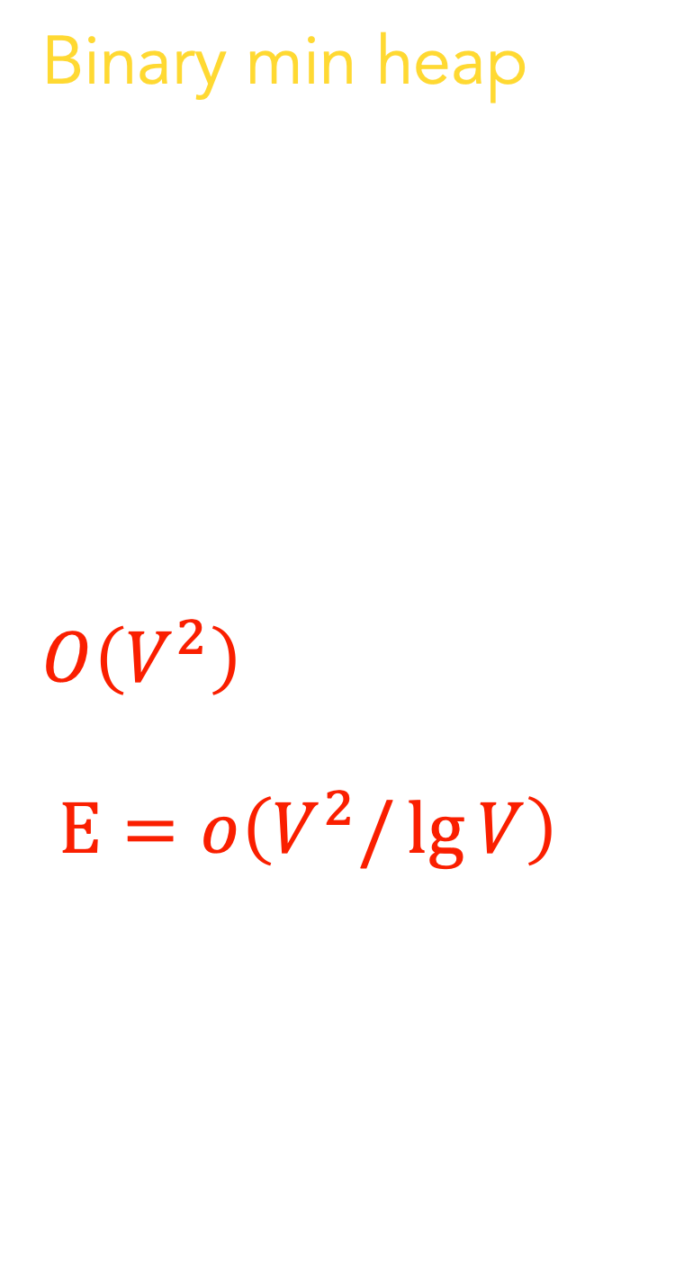
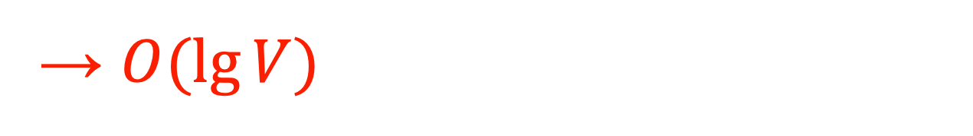
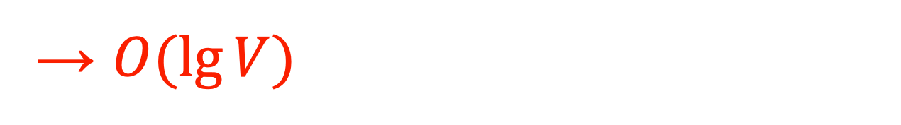
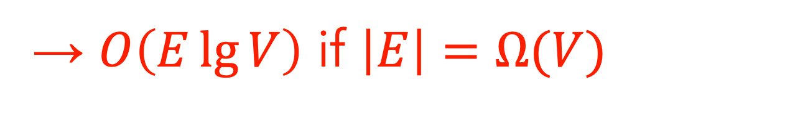

Comparing Bellman ford and Dijkstra algorithm
Refreshment on dijkstra
Total → $O\left(\left(V+E\right)\lg{V}\right)$
Binary min heap Implementation on min-priority queue Q.
Improves upon the straightforward $O\left(V^{2}\right)$ if the graph is sparse enough ($E=o\left(V^{2}/\lg{V}\right)$)
→ $O\left(E\lg{V}\right)$ if $\left|E\right|=Ω(V)$
→ $O(1)$
→ $O(V)$
→ $O(\lg{V})$
→ $O(E)$ (in total using aggregate)
→ $O(\lg{V})$
Note that we use amortized analysis here
Notes:
$\left|E\right|=Ω(V)$ means that "The number of edges in the graph is at least proportional to the number of vertices.” In other words, the number of edges in the graph is proportional to or larger than the number of vertices. The graph is relatively dense.

Slide 35

Comparing Bellman ford and Dijkstra algorithm
Refreshment on dijkstra
Total → $O\left(V\lg{V}+E\right)$
Fibonacci heap Implementation on min-priority queue Q.
→ $O(1)$
→ $O(V)$
→ $O(\lg{V})$
→ $O(E)$ (in total using aggregate)
→ $O(1)$
Note that we use amortized analysis here

Slide 36
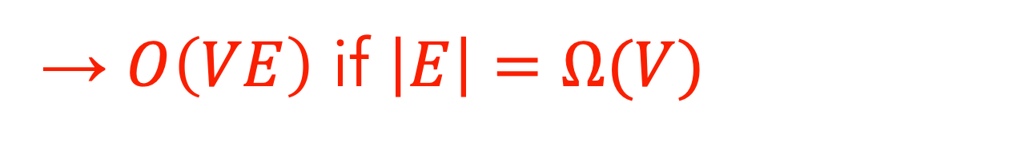
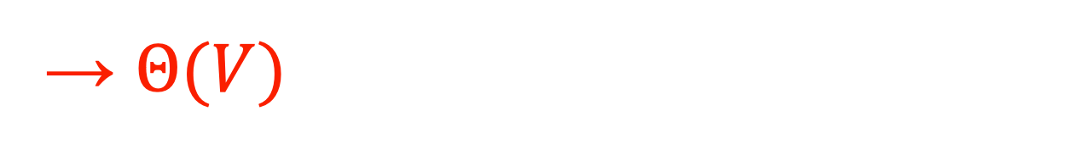

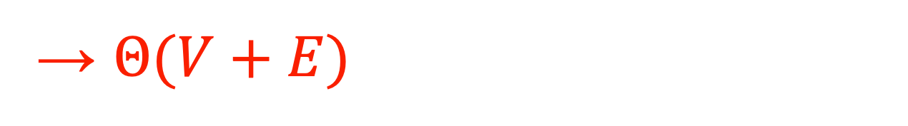

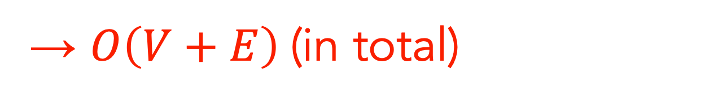
Comparing Bellman ford and Dijkstra algorithm
Bellman-ford analysis
Total → $O\left(V^{2}+VE\right)$
→ $O\left(VE\right)$ if $\left|E\right|=Ω(V)$
→ $Θ(V)$
→ $Θ(V)$
→ $Θ(V+E)$
→ $O\left(V+E\right)$(in total)
Assume that the graph is represented by adjacency lists.

Slide 37
Comparing Bellman ford and Dijkstra algorithm
Bellman-ford vs Dijkstra
Bellman-Ford:
Negative Edge Weights
Dynamic Programming Approach
Dijkstra:
Efficiency in Dense Graphs
Non-Negative Edge Weights
Greedy Approach

Slide 38
Summary
Shortest path problem is to find a shortest path between two vertices.
For single-source shortest path, the Dynamic Programming approach we can use Bellman-Ford and for Greedy approach we use Dijkstra.
For single-source shortest path, greedy approach has better solution than dynamic programming approach.

Slide 39
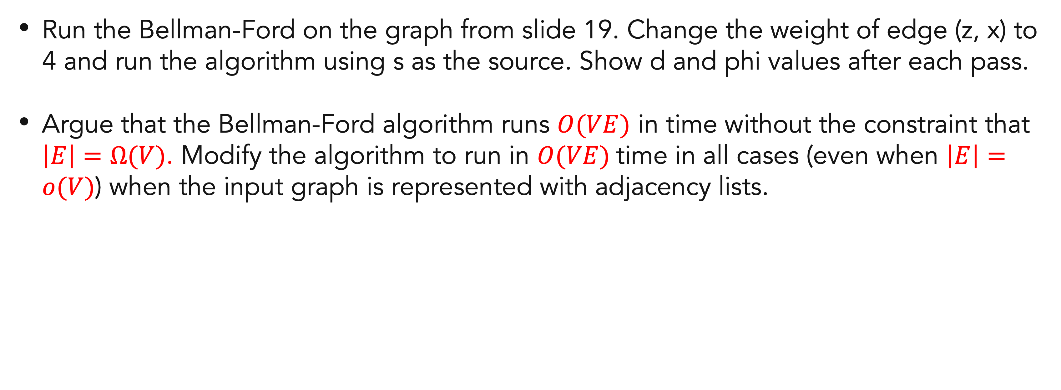
Exercises
20
Run the Bellman-Ford on the graph from slide 19. Change the weight of edge (z, x) to 4 and run the algorithm using s as the source. Show d and phi values after each pass.
Argue that the Bellman-Ford algorithm runs $O(VE)$ in time without the constraint that $\left|E\right|=Ω(V)$. Modify the algorithm to run in $O(VE)$time in all cases (even when $\left|E\right|=o(V)$) when the input graph is represented with adjacency lists.

Slide 40
References
Thomas H. Cormen. (2022). Introduction to algorithms: Fourth edition. The MIT Press. Chapter 22.

Slide 41
Thank you
Graph: Shortest path
September, 2023

